Slide 1
Benchmarking Medallion-Architecture Data Pipelines in Cloud-Computing Environments
Tianyu Sun, Evie Mahsem, Marissa Reed, Nishanth Prasad

Slide 2
Table of Contents
Overview
Medallion Layers
Key Metrics & Results
Conclusions & Future Work

Slide 3
The Problem
Real-world data is often noisy, incomplete, or inconsistent.
Organizations need scalable pipelines to clean, transform, and deliver data.
We used Randomized and Recommissioned Battery Dataset from NASA, which contains 3 stages of data with different column names.
Assess end-to-end performance and resource bottlenecks in a multi-stage data pipeline (Ingest → Bronze → Silver → Gold)

Slide 4
The Idea
Build a Medallion Architecture pipeline: Bronze -> Silver -> Gold
Deploy on different infrastructures:
Local Machine
1 node with 8 CPUs
1 node with 16 CPUs
2 nodes
3 Nodes
Instrument each stage to record runtime, CPU, memory, disk I/O, and throughput over 30 runs, enabling layer-by-layer comparison

Slide 5
Design (Medallion Architecture)
Ingest into HDFS
The data starts off on the local machine and will need to be fed into the HDFS to be used by Hadoop
In traditional companies their data would be stored in a Data Lake, Oracle or some other software.
Bronze Layer
The bronze layer is the raw data layer.
There is no changes that are done.
Silver Layer
Silver layer is for clean data that no longer as duplicates, nulls, and the data types assigned
Gold Layer
Gold layer is the final product that would be used by business folks or trained on for models.
For this project, we decided the final table should be a union between all of the silver tables.

Slide 6
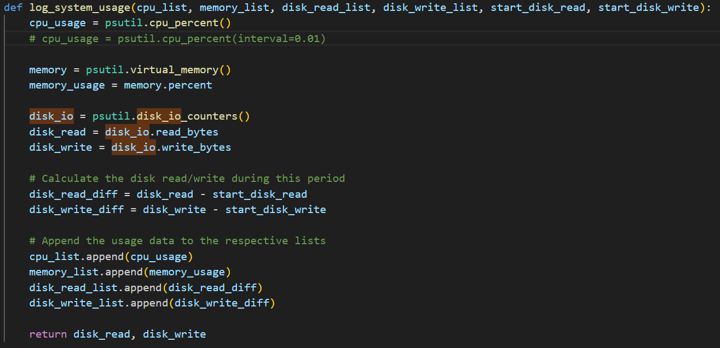
Evaluation Metrics
Runtime
CPU
Memory
Disk I/O
Throughput

Slide 7
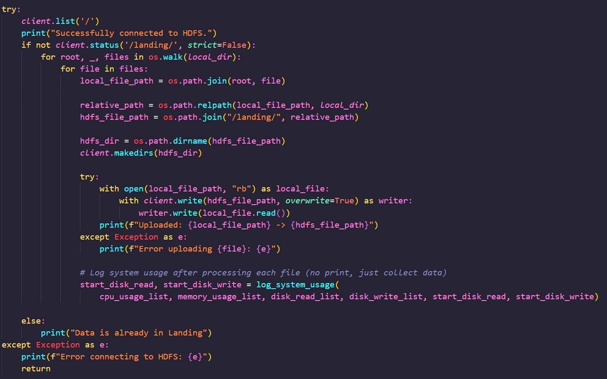
Implementation - Ingestion
Core Steps:
Connect to the HDFS
Loop through all local files
Copy the local files into their respective directories
Record metric data

Slide 8
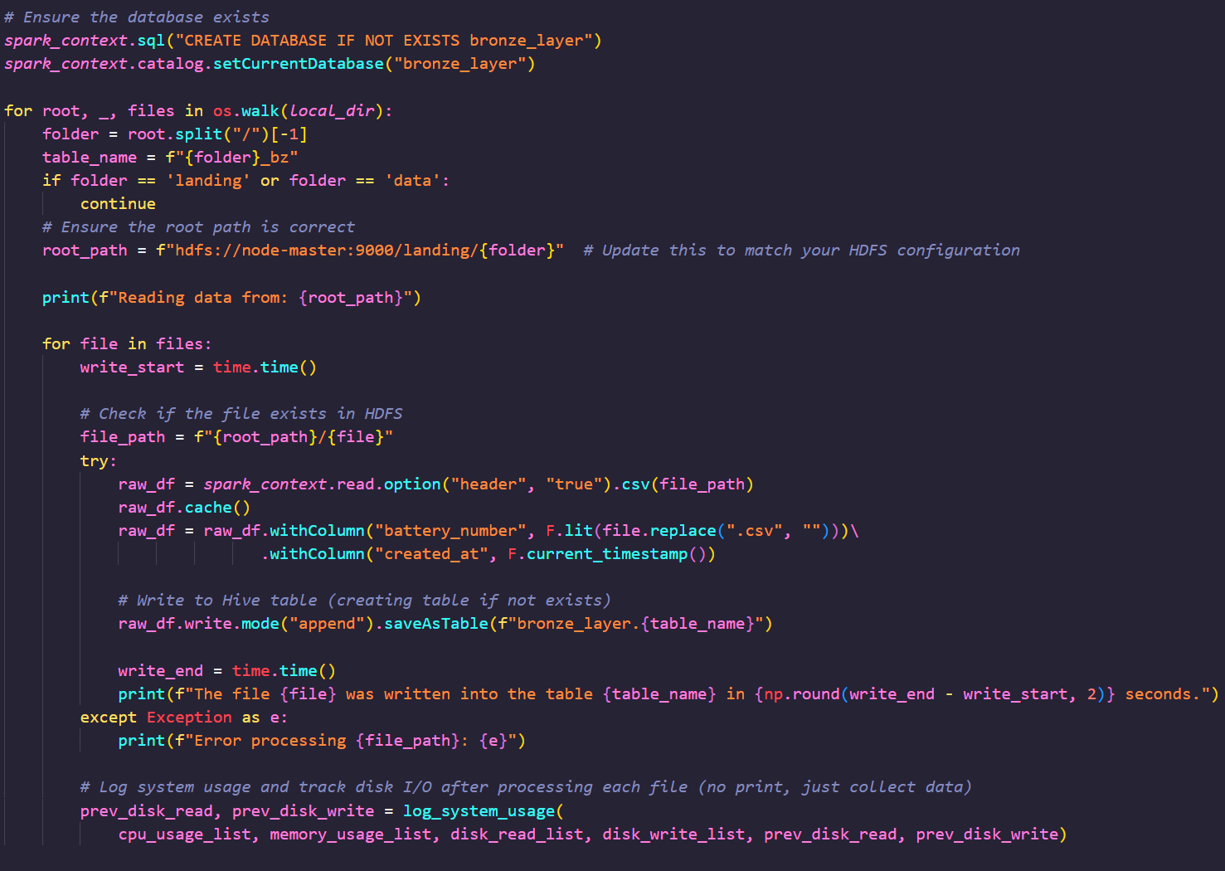
Implementation - Bronze
Core Steps:
Read the csv files
Add columns battery_number and created_at
Write files to their respective bronze tables
Collect metrics

Slide 9
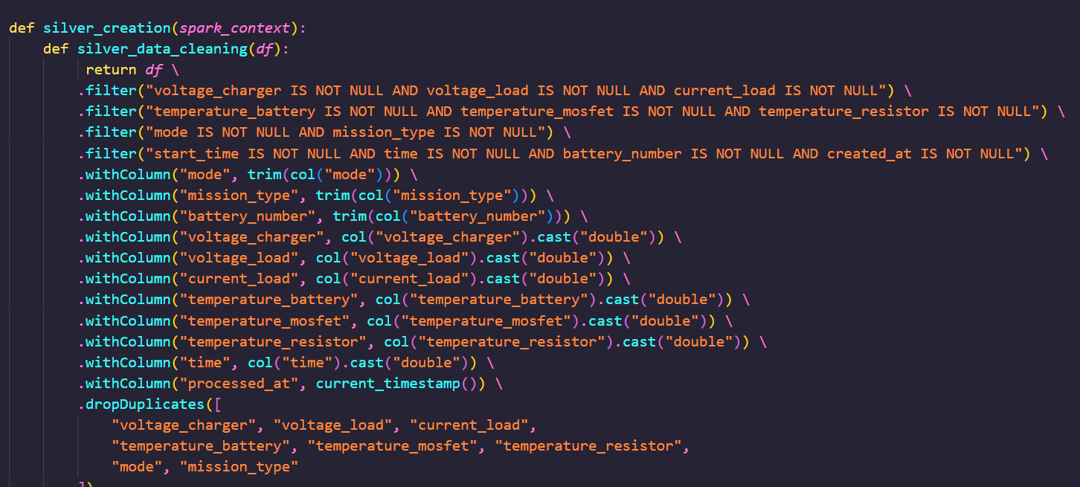
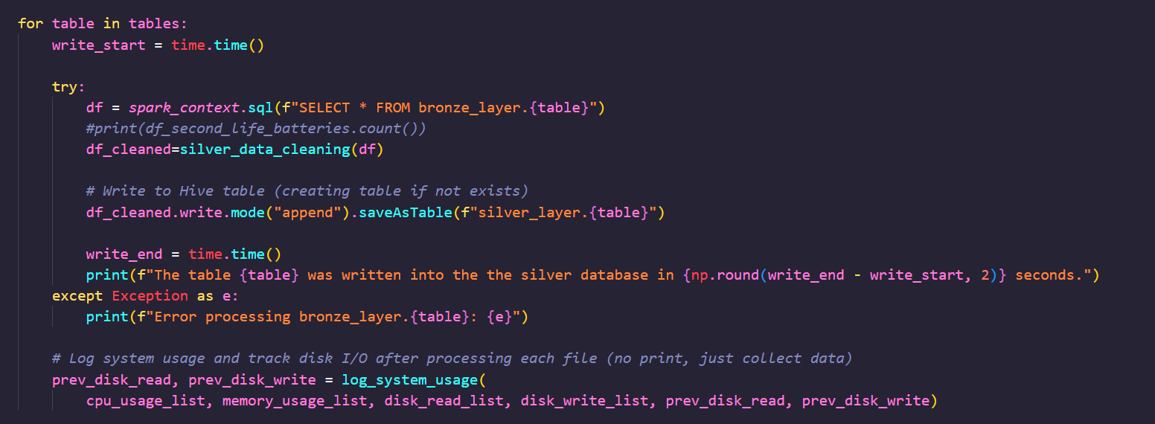
Implementation - Silver
Core Steps:
Loop through tables
Clean their data by removing nulls, duplicates, assigning data types, and trimming.
Added column processed_at
Write to respective silver tables
Collect metrics

Slide 10
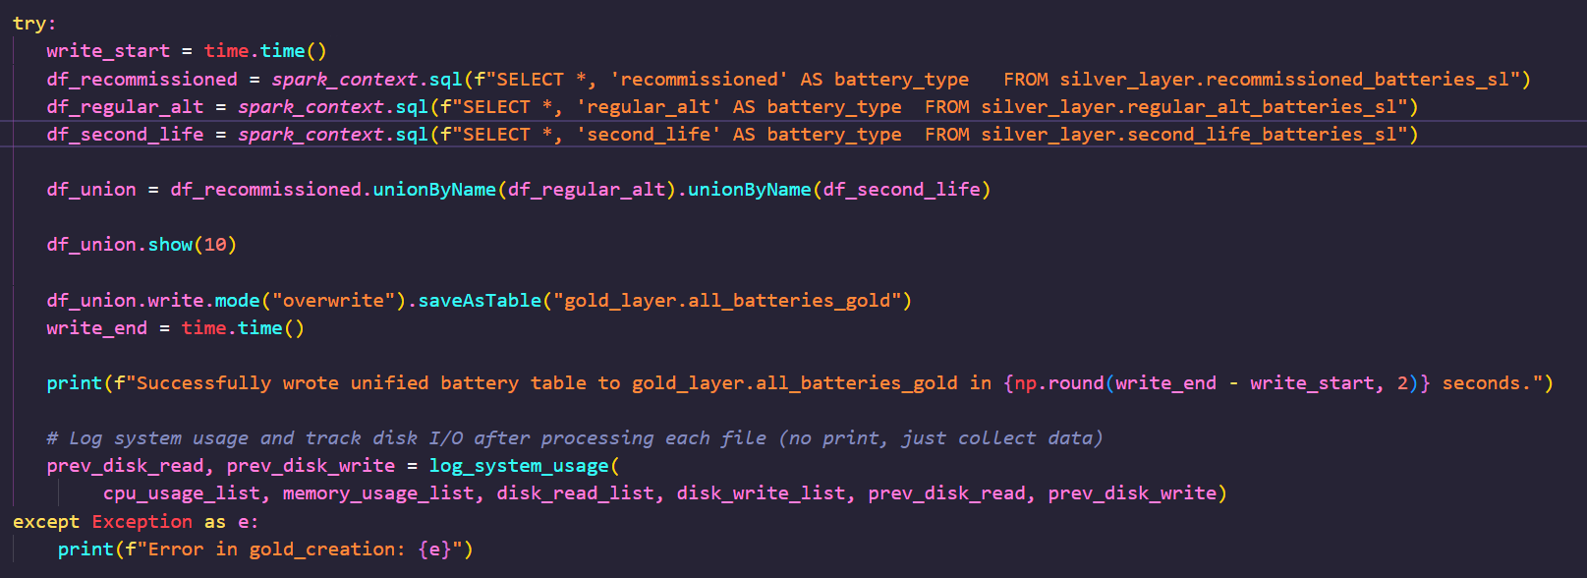
Implementation - Gold
Core Steps:
Select all tables, adding a column to each labeling battery type
Union all 3 tables into 1
Write the single gold table
Collect metrics

Slide 11
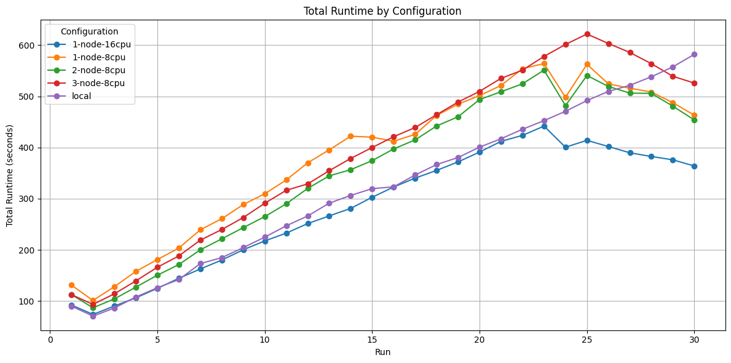
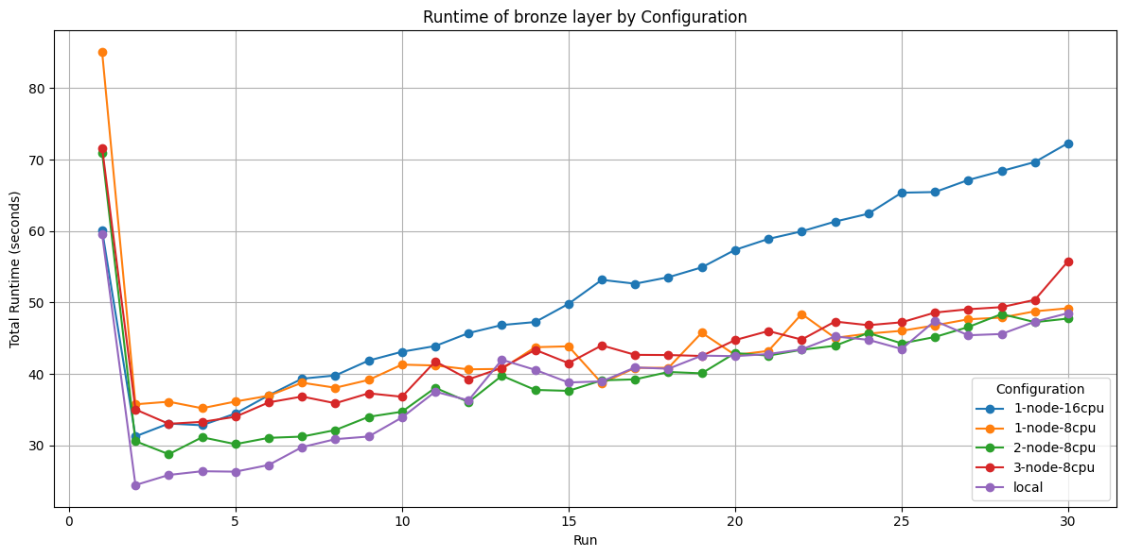
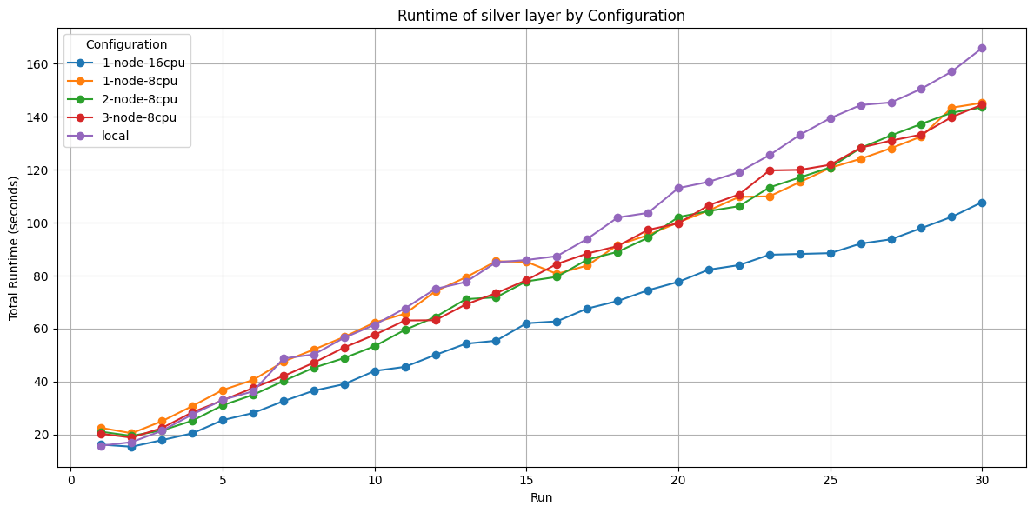
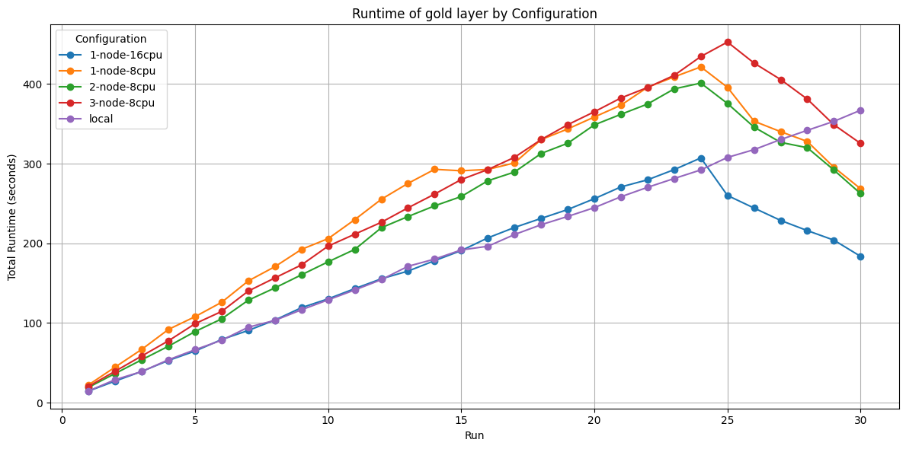
Experiment Results - Runtime
Figure: Runtime (s) for each layer

Slide 12
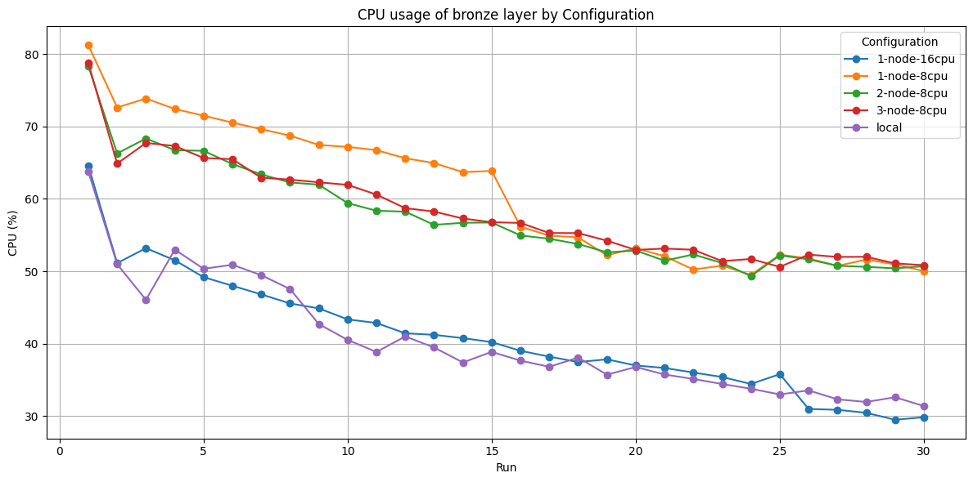
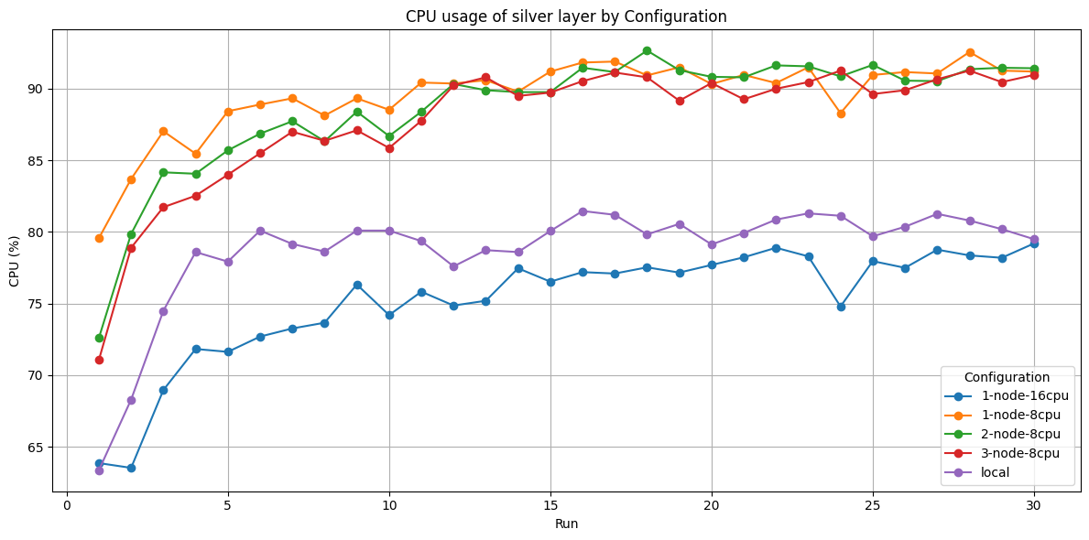
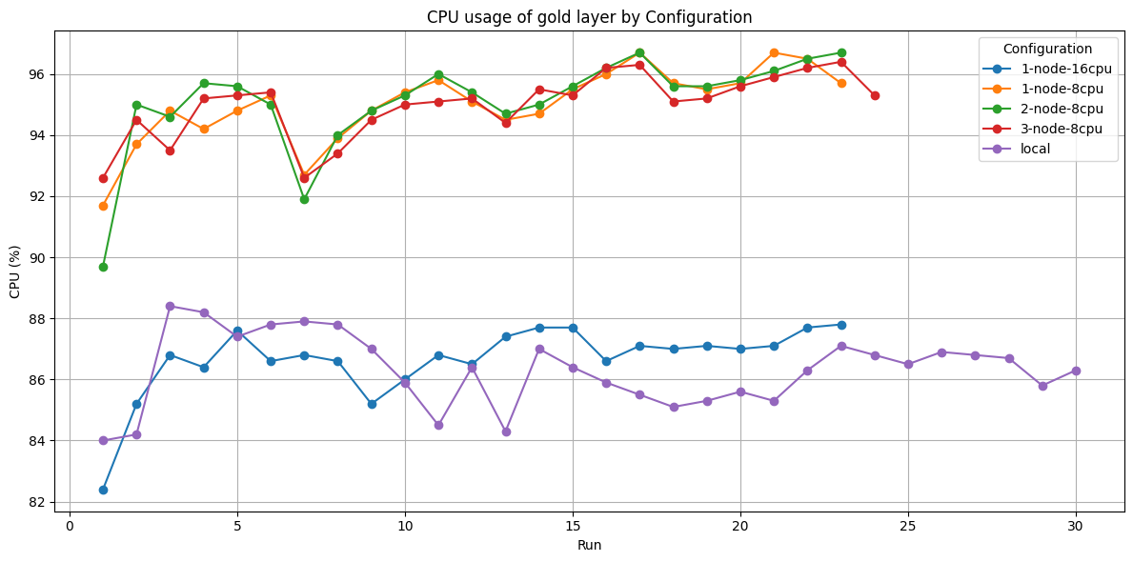
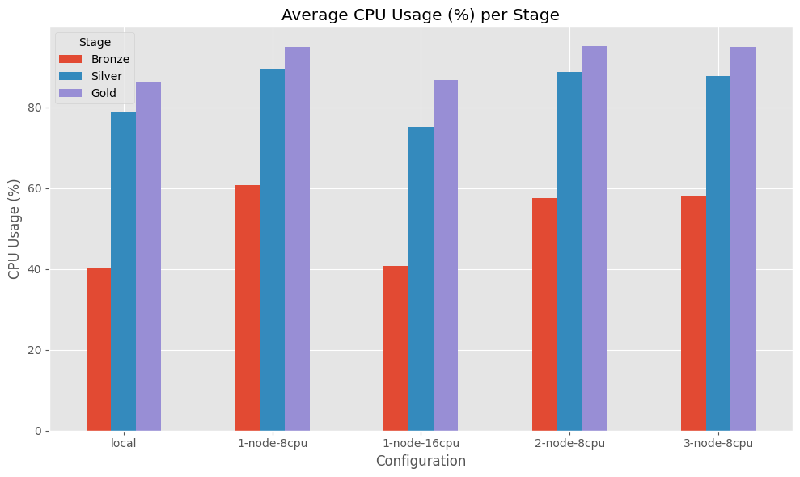
Experiment Results - CPU usage
Figure: CPU usage (%) for each layer

Slide 13
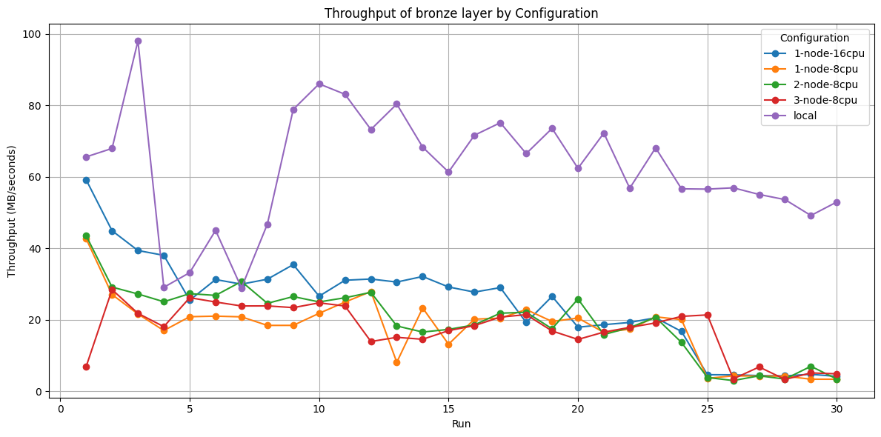
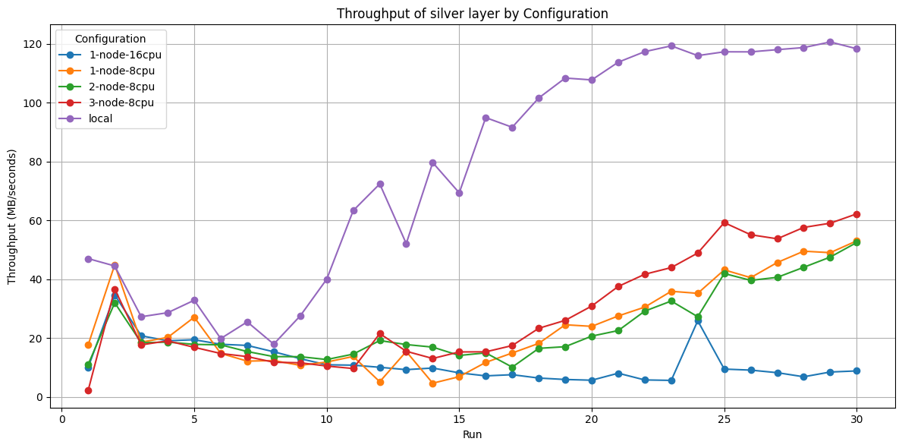
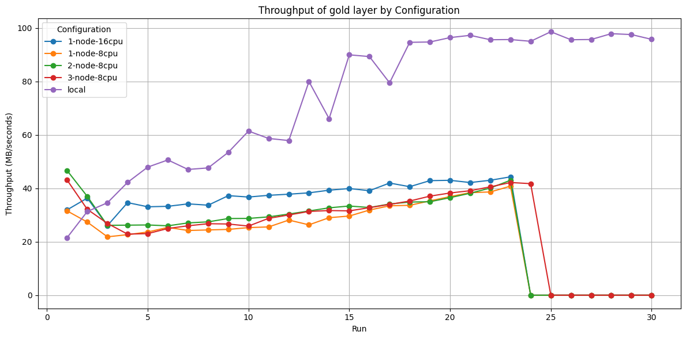
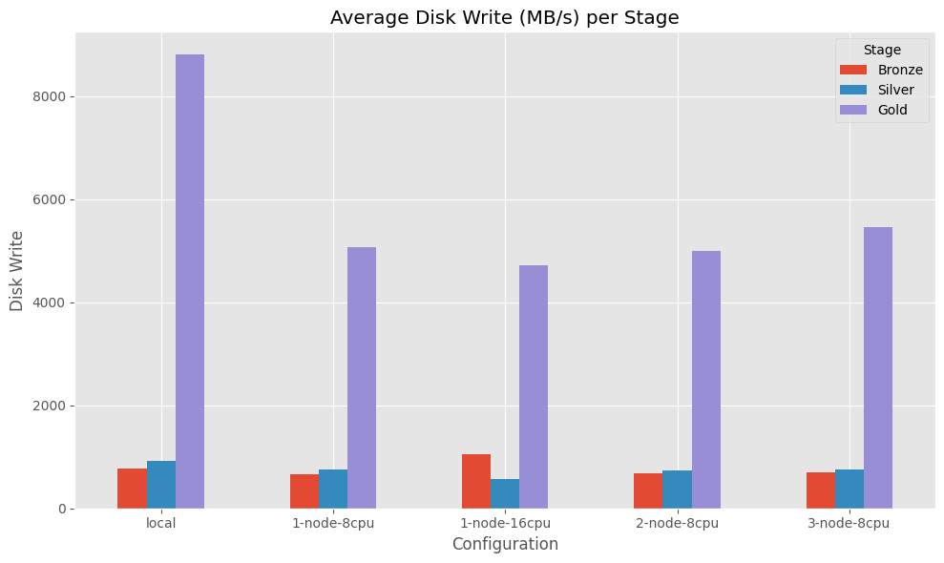
Experiment Results - Throughput
Figure: Throughput (MB/sec) for each layer

Slide 14
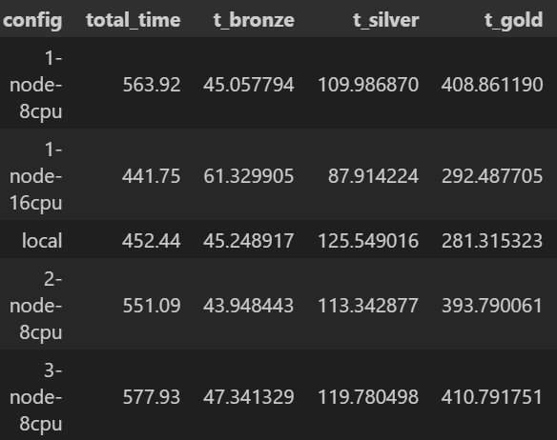
Experiment Results
Figure: Runtime at run 23

Slide 15
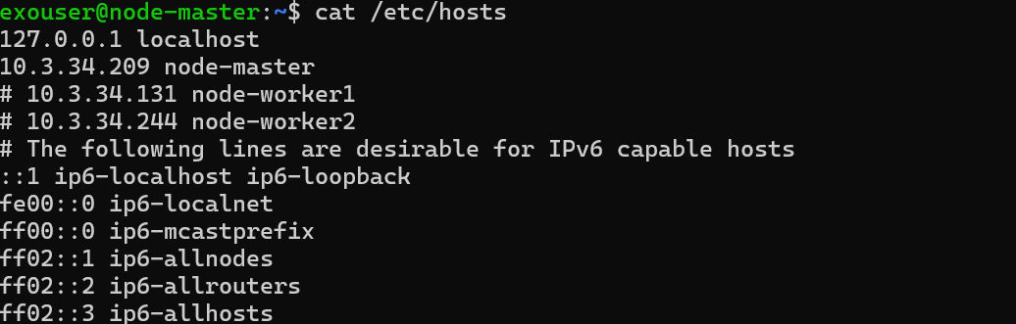
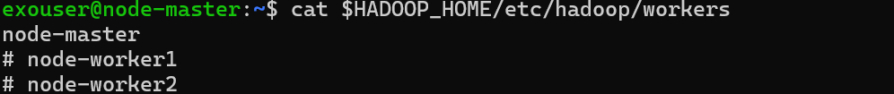
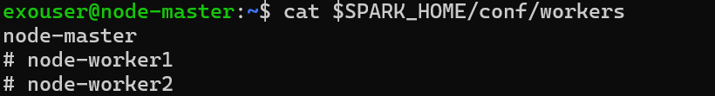
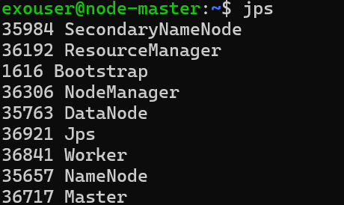
Demo (1 node, 8 CPUs)
Figure: Setup to run the code for 1 node

Slide 16
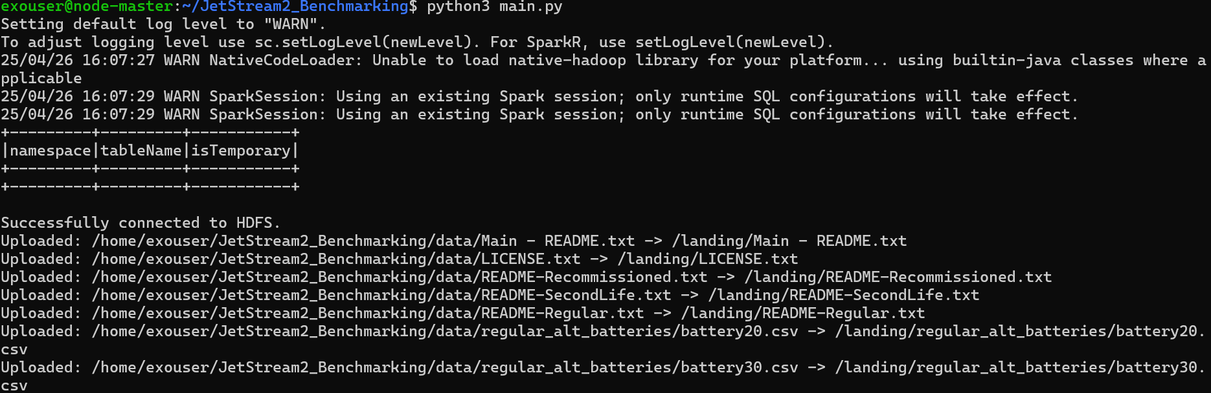
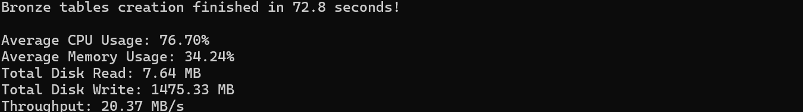
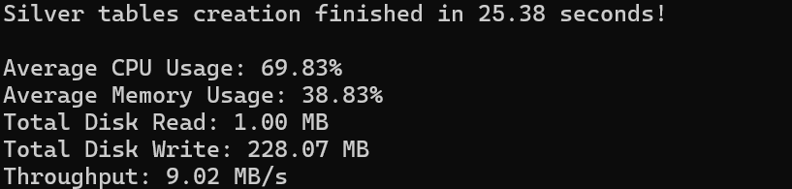
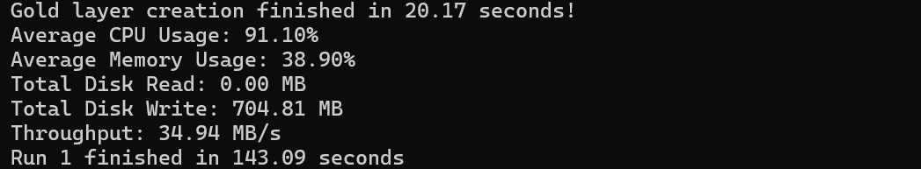
Demo (1 node, 8 CPUs)
Figure: Running the experiment for 1 node

Slide 17
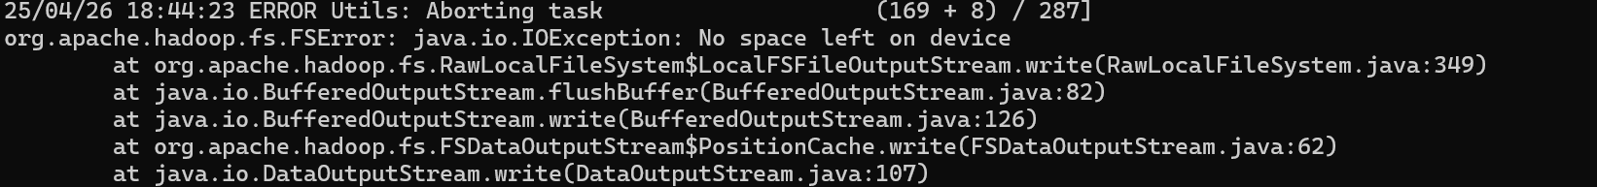
Demo (1 node, 8 CPUs)
Figure: Occurrence of breakdown at run 24

Slide 18
Key Takeaways
Bronze: Adding cores past 8 on a single VM yields diminishing returns; Bronze performance is gated by disk and network bandwidth, not compute
Silver: Silver is compute-bound. Packing more cores on a single VM beats spreading the same cores across nodes
Gold: Gold layer is storage-bandwidth–limited. Single-VM 16-core wins by avoiding shuffle

Slide 19
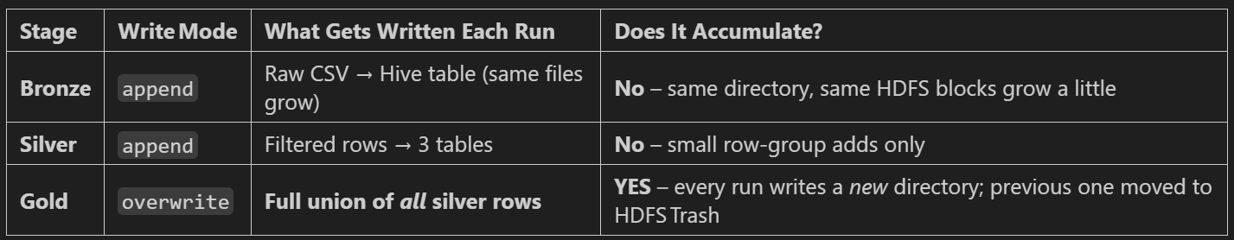
Explaination

Slide 20
Challenges
Hive and Spark versioning problems.
Hive installation and memory tuning issues
HDFS data-node storage limits (“no space left” error)

Slide 21
Future Work
Dynamic resource prediction using ML.
Further optimize Gold layer to minimize shuffle .
Explore containerization with Docker.

Slide 22
References
Armbrust, M., et al. (2015). Spark: Cluster Computing with Working Sets. USENIX Annual Technical Conference.
Zaharia, M., et al. (2016). Apache Spark: A Unified Engine for Big Data Processing. Communications of the ACM, 59(11), 56–65.
Meng, X., et al. (2016). MMLSpark: Unifying Deep Learning and Spark. In Advances in Neural Information Processing Systems.
NASA. (2020). Randomized and Recommissioned Battery Dataset. NASA Ames Research Center. Retrieved from https://data.nasa.gov
Databricks. (2021). Medallion Architecture for Data Lakes. Databricks Documentation. Retrieved from https://docs.databricks.com
Shvachko, K., et al. (2010). The Hadoop Distributed File System. IEEE 26th Symposium on Mass Storage Systems and Technologies.
Dean, J., & Ghemawat, S. (2004). MapReduce: Simplified Data Processing on Large Clusters. OSDI.

